Slide 1
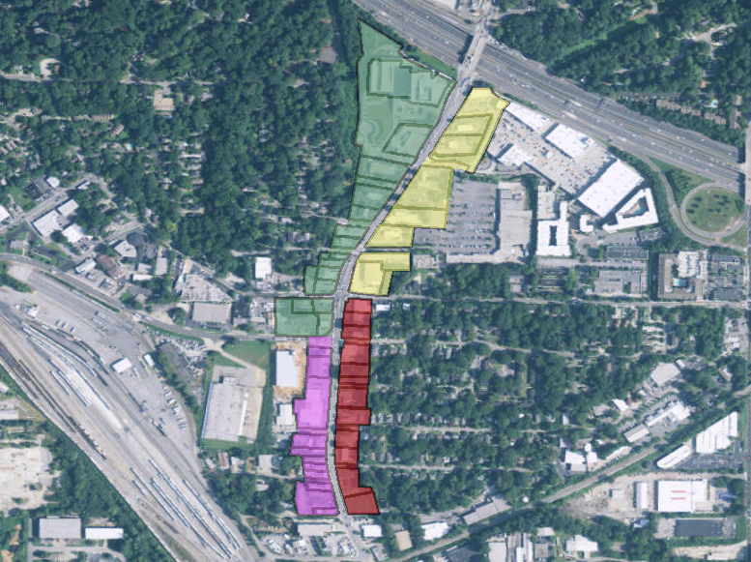
Howell Mill Road Rezoning Z-15-024
Howell Mill Rd.
September 10, 2015

Slide 2
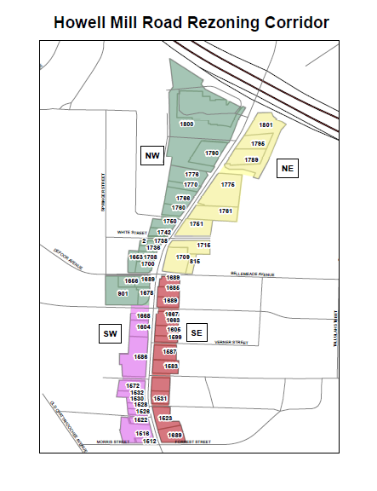
Z-15-024
Office of Planning
Background & Intent
Previous studies along or related to this stretch of the Howell Mill Road included:
Berkeley Park Blueprints Plan (2004)
Connect Atlanta Plan (2008)
Upper Westside Livable Communities Initiative (LCI) Update (2009)
BeltLine Master Plan -Subarea 8 (2009)
Cycle Atlanta Plan (2013)
Collier Village Blueprints Plan (2013)
These provided the basis for meetings held with stakeholders including property owners, business owners and residents of the Berkeley Park and Underwood Hills neighborhoods with an intention to:
Improve land use, zoning, urban design, open space, transportation & environment while
Promoting development; and
Protecting adjacent neighborhoods

Slide 3
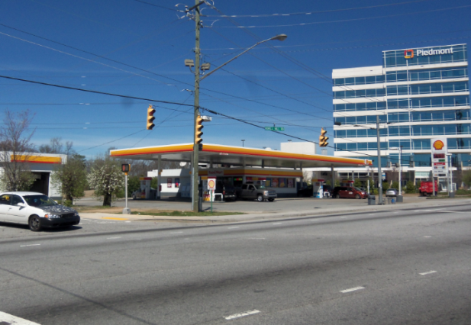
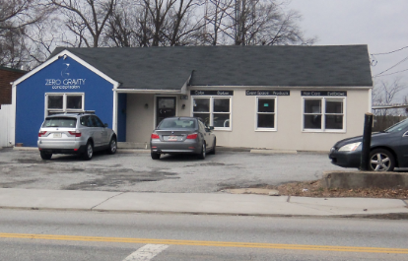
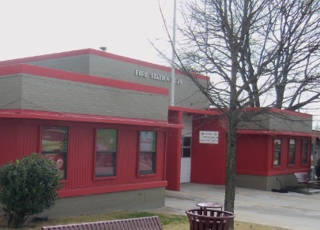
Z-15-024
Office of Planning
Existing Conditions
The current area has a variety of viable low density commercial, office, institutional and limited multi-family land uses; however, these uses are not vertically integrated and heavily oriented to the automobile including many auto-repair facilities and drive-thru uses.

Slide 4
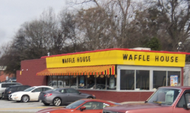
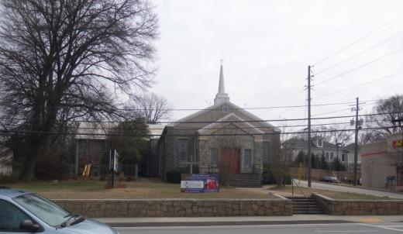
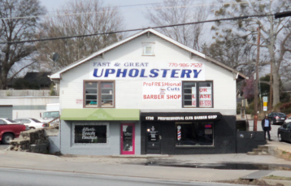
Z-15-024
Office of Planning
Zoning Conditions (General)
Prohibited uses: Car washes, storage facilities, tattoo and body piercing, pawnshops, nightclubs, etc.
Limited hours: No operations 2:00–6:30 AM except if >50 feet from residential and the uses are either:
Retail in combination with fuel dispensing; or
Medical health facilities; or
Existing eating and drinking establishments currently operating before 6:30 AM;
Transitional uses/yards: No drive-through, drive-in or auto related facilities <100 feet of residential. Paving prohibited <20 foot of residential unless providing shared access.
Shared Access: Between adjacent non-residential uses min. 20’ shared access with a 10% parking reduction.
Fencing/walls: No barbed/razor wire/uncoated chain link.
Residential useable open space requirement(USOR):
At least 10% USOR provided as uncovered, accessible and at finished grade.
At most 50% USOR at rooftop level.

Slide 5
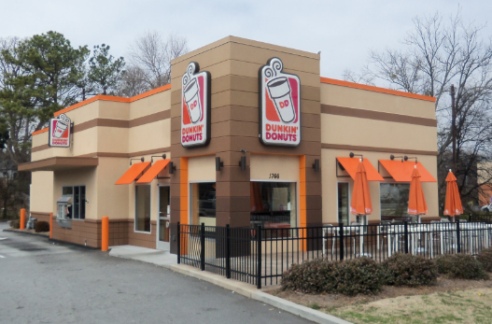
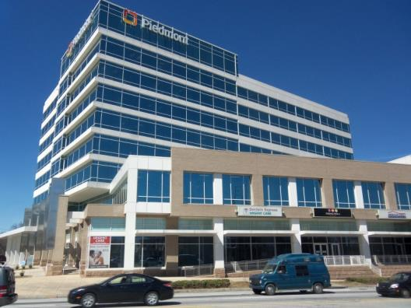
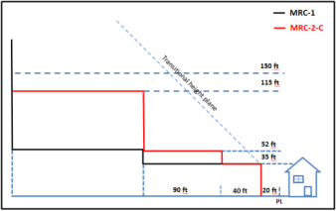
Z-15-024
Office of Planning
Zoning Conditions (Underwood Hills NW)
Uses limited: Max. 2 fuel dispensing establishments & max. 3 auto-focused establishments.
Density: Non-residential 1.0 max FAR for south addresses within this subarea.
Height limit: Max 35’ ht. within 60’ of residential otherwise:
North addresses (near I-75): 115’ ht. then 150’ ht.
South addresses: 52’ ht. then 80’ ht. or 115’ ht.
Front Setback/Sidewalks:
20’ setback along Howell Mill Rd. for any future ROW work (This setback can be counted for USOR and public space requirement).
Min. 4’ foot street furniture/tree planting zone, min. 6’ clear sidewalk.

Slide 6
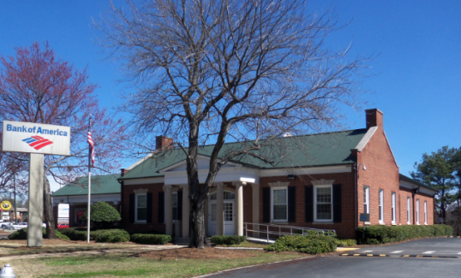
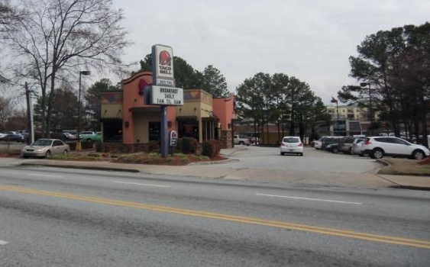
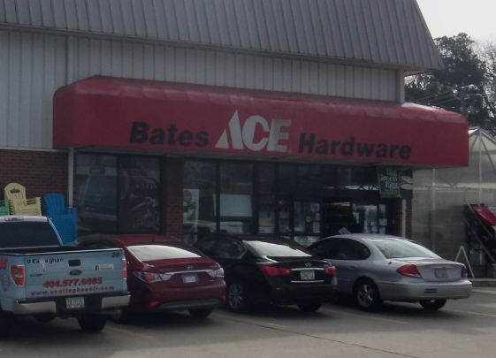
Z-15-024
Office of Planning
Zoning Conditions (NE)
Density: Non-residential 1.5 max FAR.
Height limit: Max 35’ ht. within 60’ of R-1 through R-5 zoning. Otherwise:
North addresses (near I-75): 115’ ht.
South addresses: 80’ ht.
Front Setback/Sidewalks:
20’ setback along Howell Mill Rd. for any future ROW work (This setback can be counted for USOR and public space requirement).
Min. 4’ foot street furniture/tree planting zone, min. 6’ clear sidewalk.

Slide 7
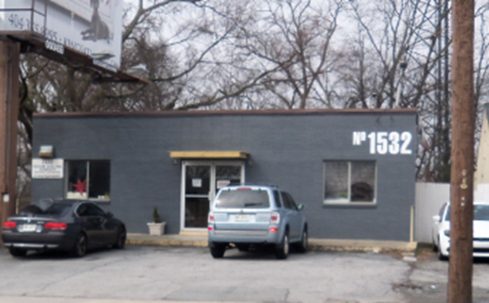
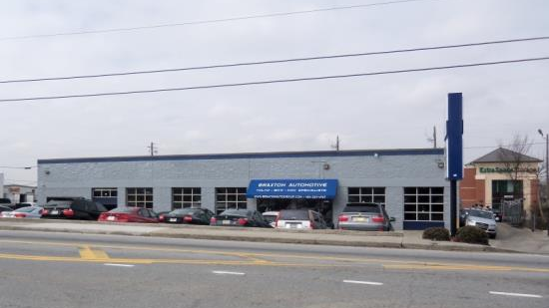
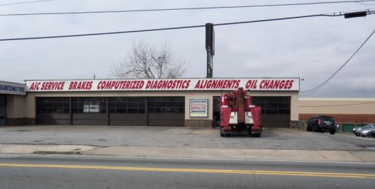
Z-15-024
Office of Planning
Zoning Conditions (SW)
Uses limited: Non-residential limited <12,000 square feet. Drive through and/or drive-in uses prohibited.
Density: Non-residential 1.5 max FAR.
Height limit: Max. 115’ ht.
Access Management: If accessible from a side street only 1 right out only onto Howell Mill Rd. allowed. If not accessible from a side street, only 1 two-way curb or 2 one-way curbcuts allowed along Howell Mill Rd.
Front Setback/Sidewalk:
15’ setback along Howell Mill Rd. for any future ROW work (This setback can be counted for USOR and public space requirement).
Min. 4’ foot street furniture/tree planting zone, min. 6’ clear sidewalk.

Slide 8
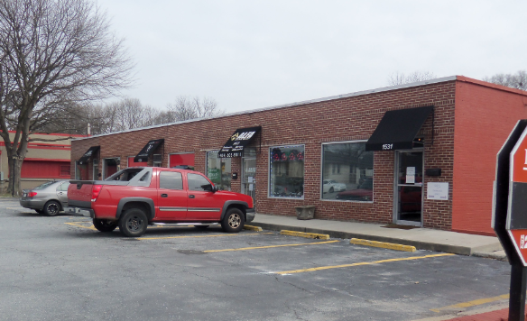
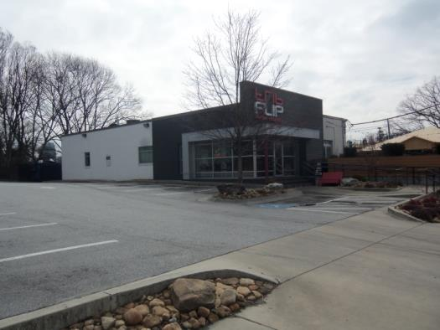
Z-15-024
Office of Planning
Zoning Conditions (Berkeley Park SE)
Uses limited: Non-residential limited <12,000 square feet. Drive through and/or drive-ins prohibited.
Density: Non-residential uses shall not exceed 1.0 times the net lot area within this subarea.
Height limit: Max 35’ ht. within 60’ of residential, 52’ ht. within 60’-150’ of residential, otherwise 80’.
Access Management: If accessible from a side street only 1 right out only onto Howell Mill Rd. allowed. If not accessible from a side street, only 1 two-way curb or 2 one-way curbcuts allowed along Howell Mill Rd.
Front Setback/Sidewalk:
15’ setback along Howell Mill Rd. for any future ROW work (This setback can be counted for USOR and public space requirement).
Min. 4’ foot street furniture/tree planting zone, min. 6’ clear sidewalk.

Slide 9
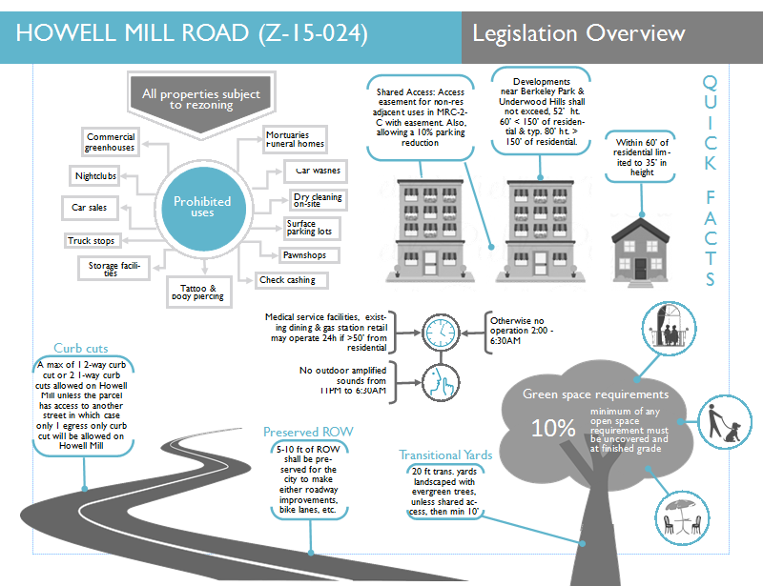
Z-15-024
Office of Planning

Slide 10
Howell Mill Road Rezoning Z-15-024
Howell Mill Rd.
September 10, 2015

